Slide 1


CHAT APPLICATION
Cloud Academy Capstone Presentation
By AWS Group 5
Notes:
JAck

Slide 2
Agenda
1. | Assumptions | 03
2. | Understanding & Objectives | 03
3 | Analysis and Approach | 04
4. | Technical Implementation | 05
5. | Screenshots | 06
6. | Technical Demo | 11
7. | Final Reflections | 12
8. | References | 13
Notes:
Jack

Slide 3
Project Overview
Chat Application
Main Assumptions
1. User Availability: Users are assumed to have reliable internet connectivity and uninterrupted access to the chat application
2. Modern Web Browsers: Usage on modern web browsers that support WebSocket technology and required web standards.
3. AWS Service Availability: Availability and accessibility of required AWS services for integration and usage throughout development and deployment.
4. Scalability and Performance: Can scale to handle expected user load and message throughput. Performance testing and optimization may be required for high usage scenarios.
Understanding & Objectives
Provide a Secure Communication Platform: Develop a chat application that ensures the security and privacy within the organization.
Foster Collaboration and Efficiency: Enhance collaboration and efficiency within the organization by providing a user-friendly and intuitive chat application. This includes features such as real-time messaging, chat room management, and user-friendly interfaces.

Slide 4
Our Approach
Design the architecture of the project and decide the flow of the Application.
Build a working backend in AWS console with functional API endpoints.
Add the database to store the incoming traffic.
Assemble frontend web pages and integrate with existing API.

Slide 5
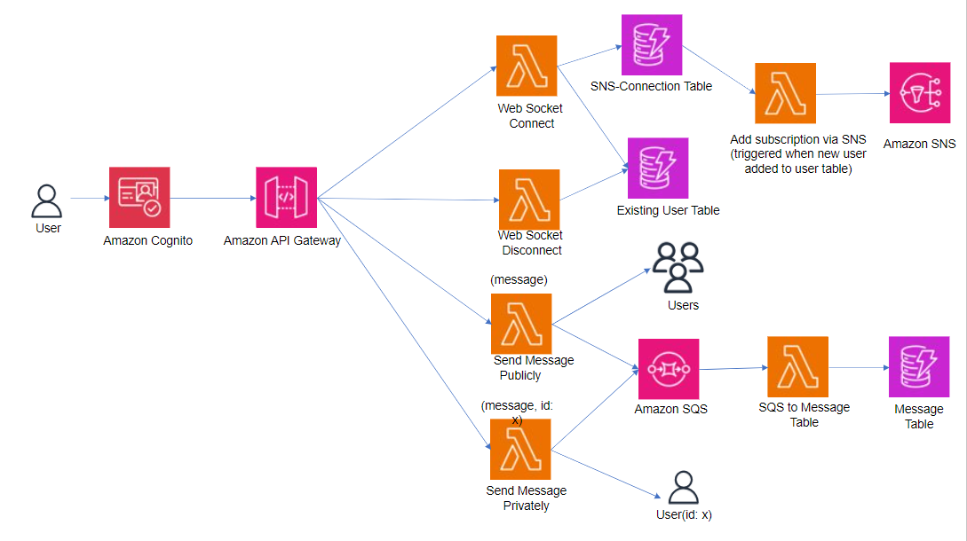
Technical Implementation
Chat Application
The chat application uses Amazon services for key functionalities.
Amazon Cognito is used for user authentication.
Amazon API Gateway manages WebSocket connections for real-time communication.
Messages are sent to Amazon SQS and stored in DynamoDB's Message Table.
Amazon SNS is used for notifying existing users when new users are added.
AWS Lambda functions are activated by events from the API Gateway, SQS, and SNS.
These functions manage updates to DynamoDB's User and Message Tables.
The architecture ensures scalability and high availability of the application.

Slide 6
Application Screenshots

Slide 7
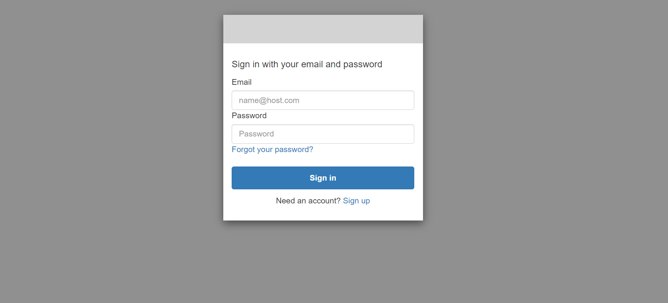
Sign In/Sign Up Page

Slide 8
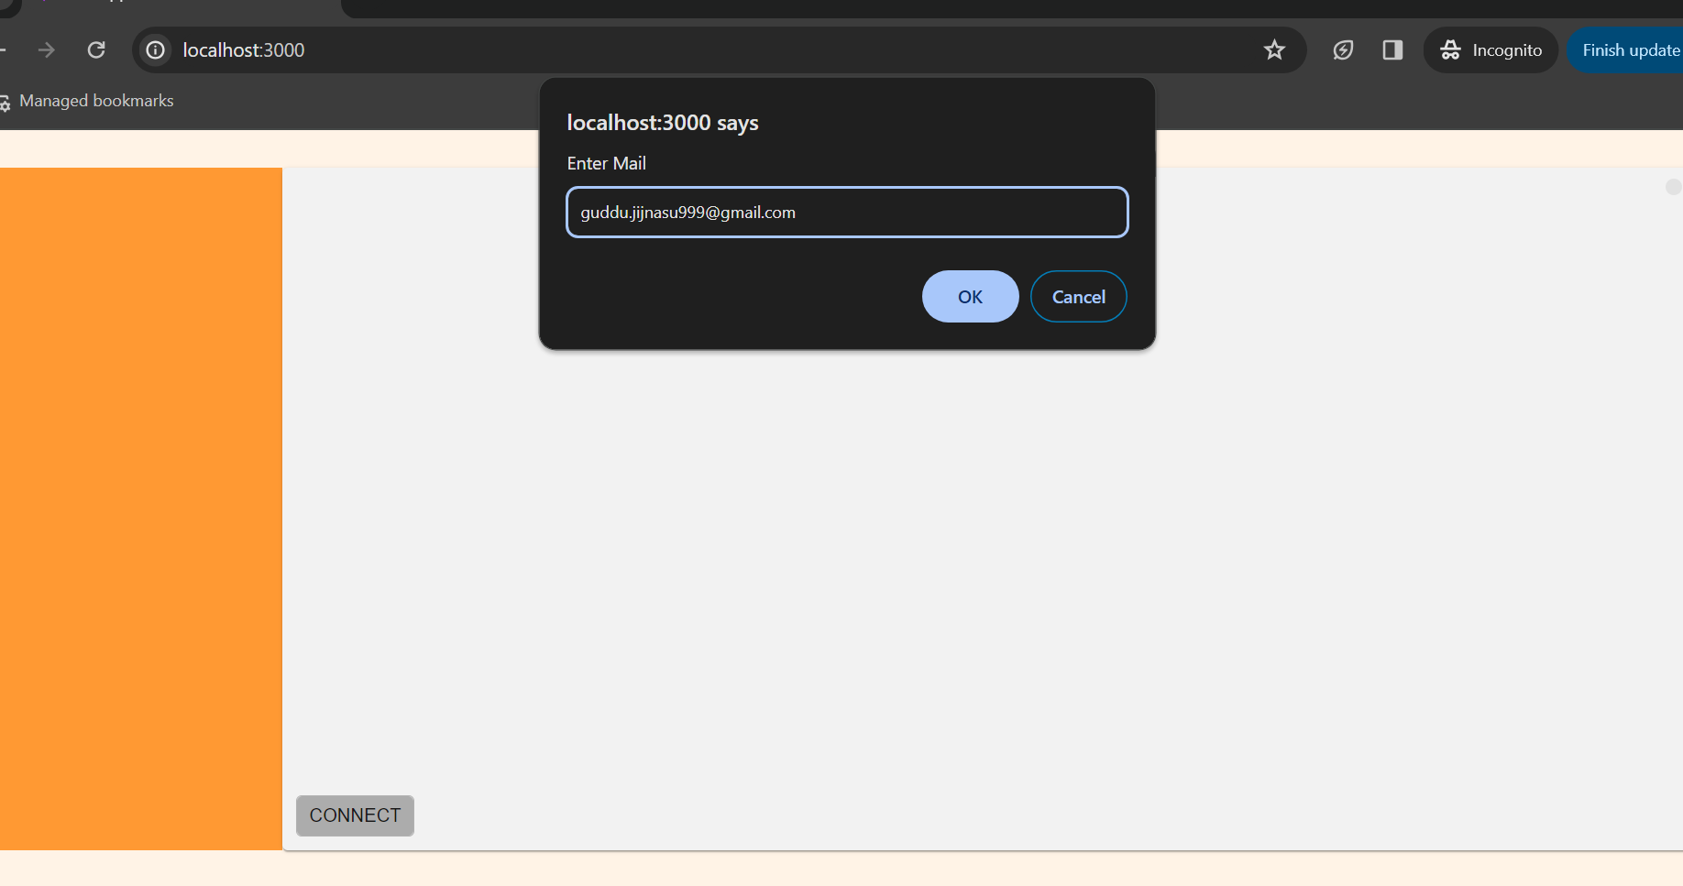
Homepage

Slide 9
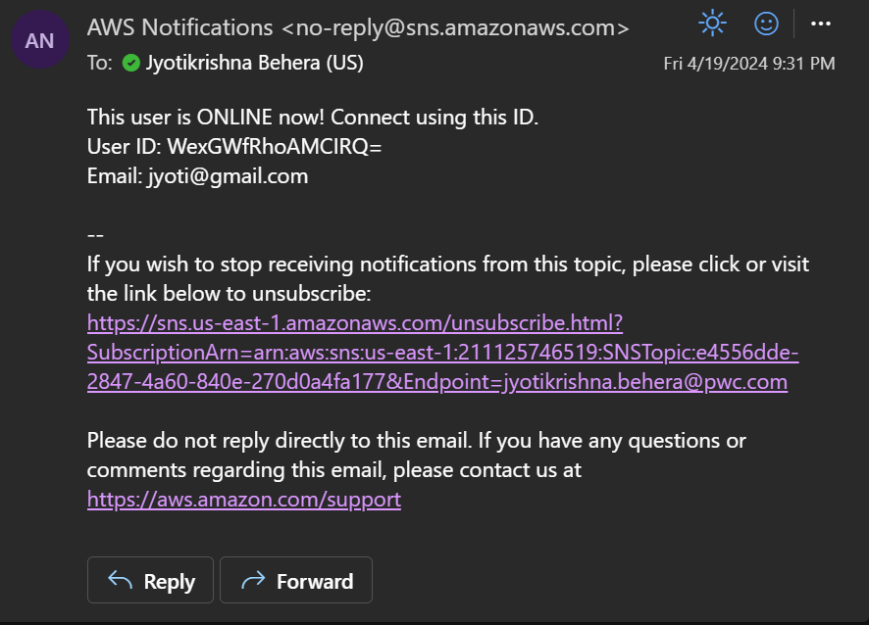
Notification of user online

Slide 10
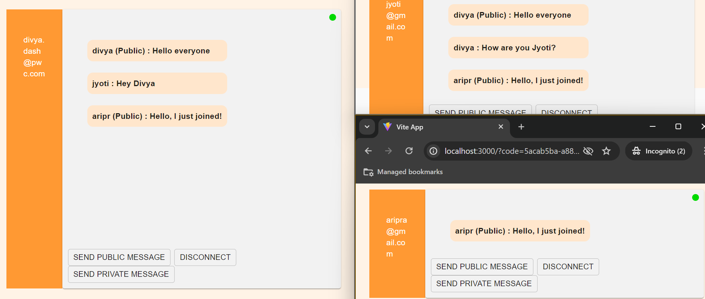
Sending Message Publicly

Slide 11
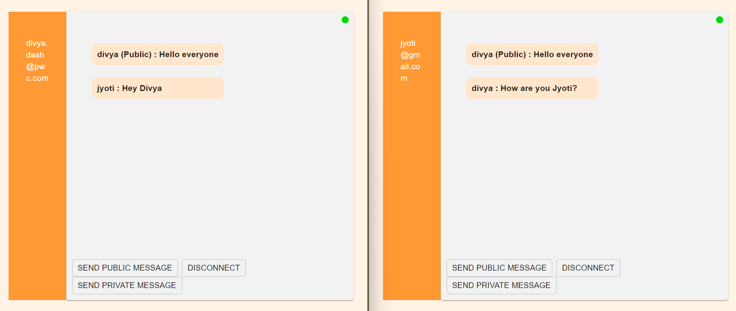
Sending Message Privately

Slide 12

Technical Demo
Chat Application

Slide 13
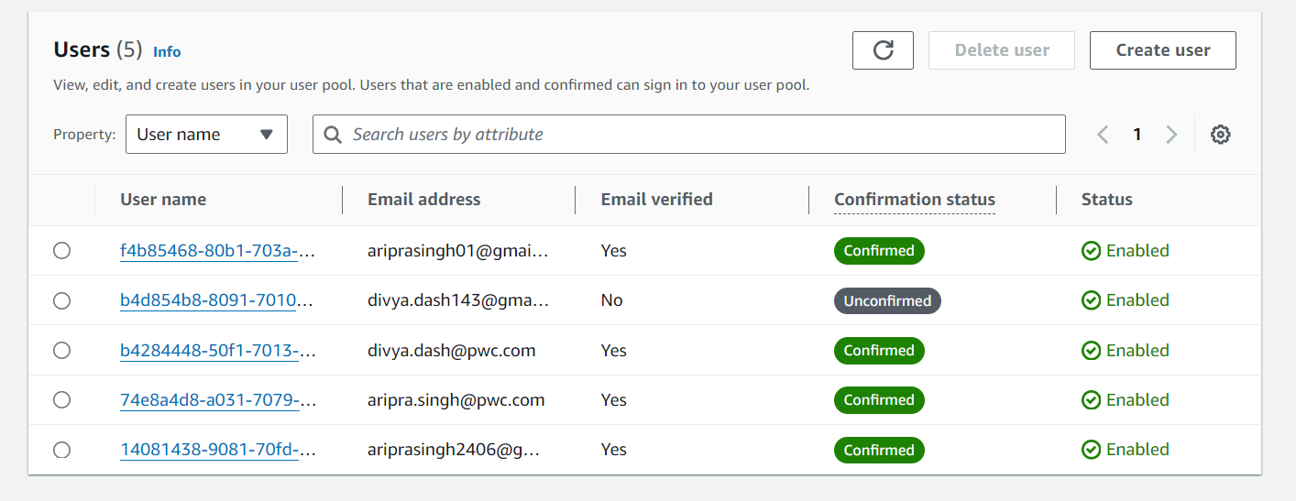
Cognito User Pool

Slide 14
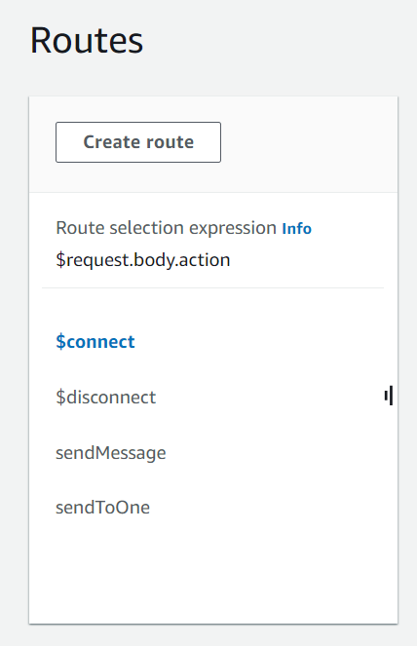
API Gateway

Slide 15
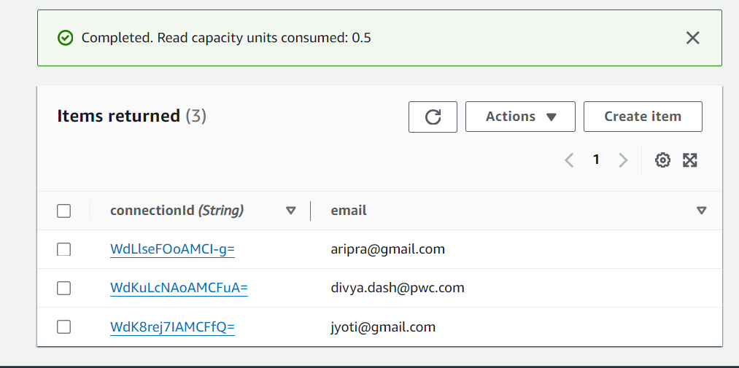
Users Table

Slide 16
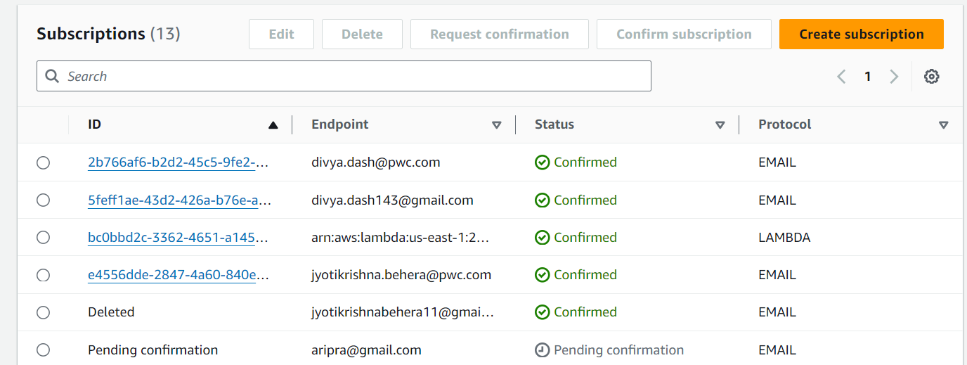
SNS Subscriptions

Slide 17
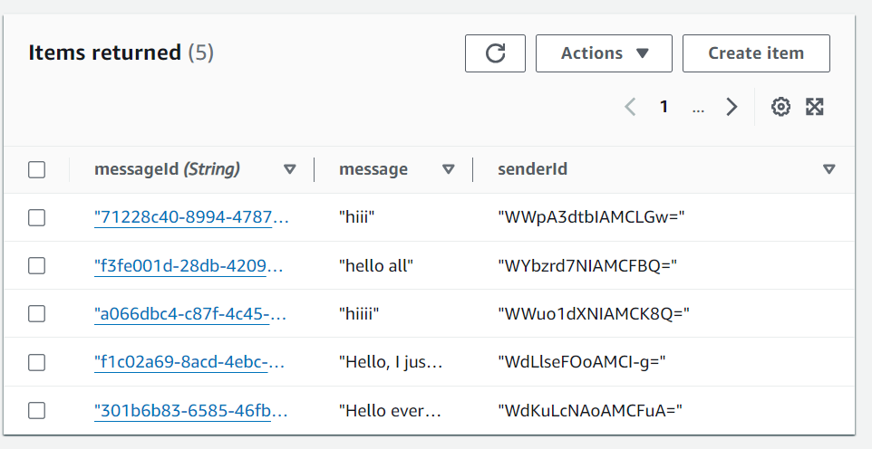
Chats Table

Slide 18
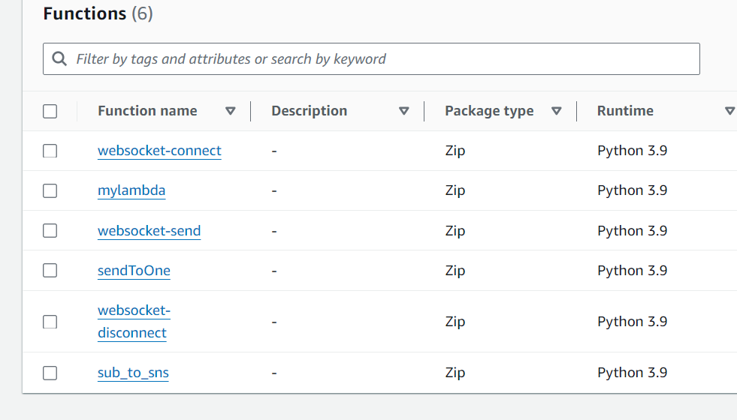
Lambda Functions

Slide 19
Reflections & Future Extensions
© 2022 PwC. All rights reserved. Not for further distribution without the permission of PwC. “PwC” refers to the network of member firms of PricewaterhouseCoopers International Limited (PwCIL), or, as the context requires, individual member firms of the PwC network. Each member firm is a separate legal entity and does not act as agent of PwCIL or any other member firm. PwCIL does not provide any services to clients. PwCIL is not responsible or liable for the acts or omissions of any of its member firms nor can it control the exercise of their professional judgment or bind them in any way. No member firm is responsible or liable for the acts or omissions of any other member firm nor can it control the exercise of another member firm’s professional judgment or bind another member firm or PwCIL in any way.

Slide 20
Reflections & Future Extensions
Reflections:
The serverless architecture using AWS services has provided scalability and high availability.
The use of Amazon Cognito, API Gateway, SQS, SNS, and DynamoDB has enabled efficient user authentication, real-time communication, message handling, and data storage.
Future Extensions:
Media File Sharing: The application can be extended to support media file sharing. AWS S3 can be used for storing and retrieving these media files. This would involve integrating the S3 service with the current architecture and modifying the frontend and backend to handle media files.
Secure Storage of Database Credentials: To enhance the security of the application, the database credentials can be stored in AWS Secrets Manager. This would involve modifying the Lambda functions to retrieve the credentials from Secrets Manager.

Slide 21
References
AWS Documentation:
Using Lambda with Amazon SQS - AWS Lambda
Tutorial: Building a serverless chat app with a WebSocket API, Lambda and DynamoDB - Amazon API Gateway
Using AWS Lambda with Amazon DynamoDB - AWS Lambda
Using Lambda with Amazon SQS - AWS Lambda
Using AWS Lambda with Amazon SNS - AWS Lambda
Working with WebSocket APIs - Amazon API Gateway
Amazon Simple Queue Service Documentation
Amazon Simple Notification Service Documentation
AWS Lambda Documentation (amazon.com)
Chat PwC:
https://chat.pwc.com/

Slide 22
Thank you
pwc.com
© 2022 PwC. All rights reserved. Not for further distribution without the permission of PwC. “PwC” refers to the network of member firms of PricewaterhouseCoopers International Limited (PwCIL), or, as the context requires, individual member firms of the PwC network. Each member firm is a separate legal entity and does not act as agent of PwCIL or any other member firm. PwCIL does not provide any services to clients. PwCIL is not responsible or liable for the acts or omissions of any of its member firms nor can it control the exercise of their professional judgment or bind them in any way. No member firm is responsible or liable for the acts or omissions of any other member firm nor can it control the exercise of another member firm’s professional judgment or bind another member firm or PwCIL in any way.

